Slide 1
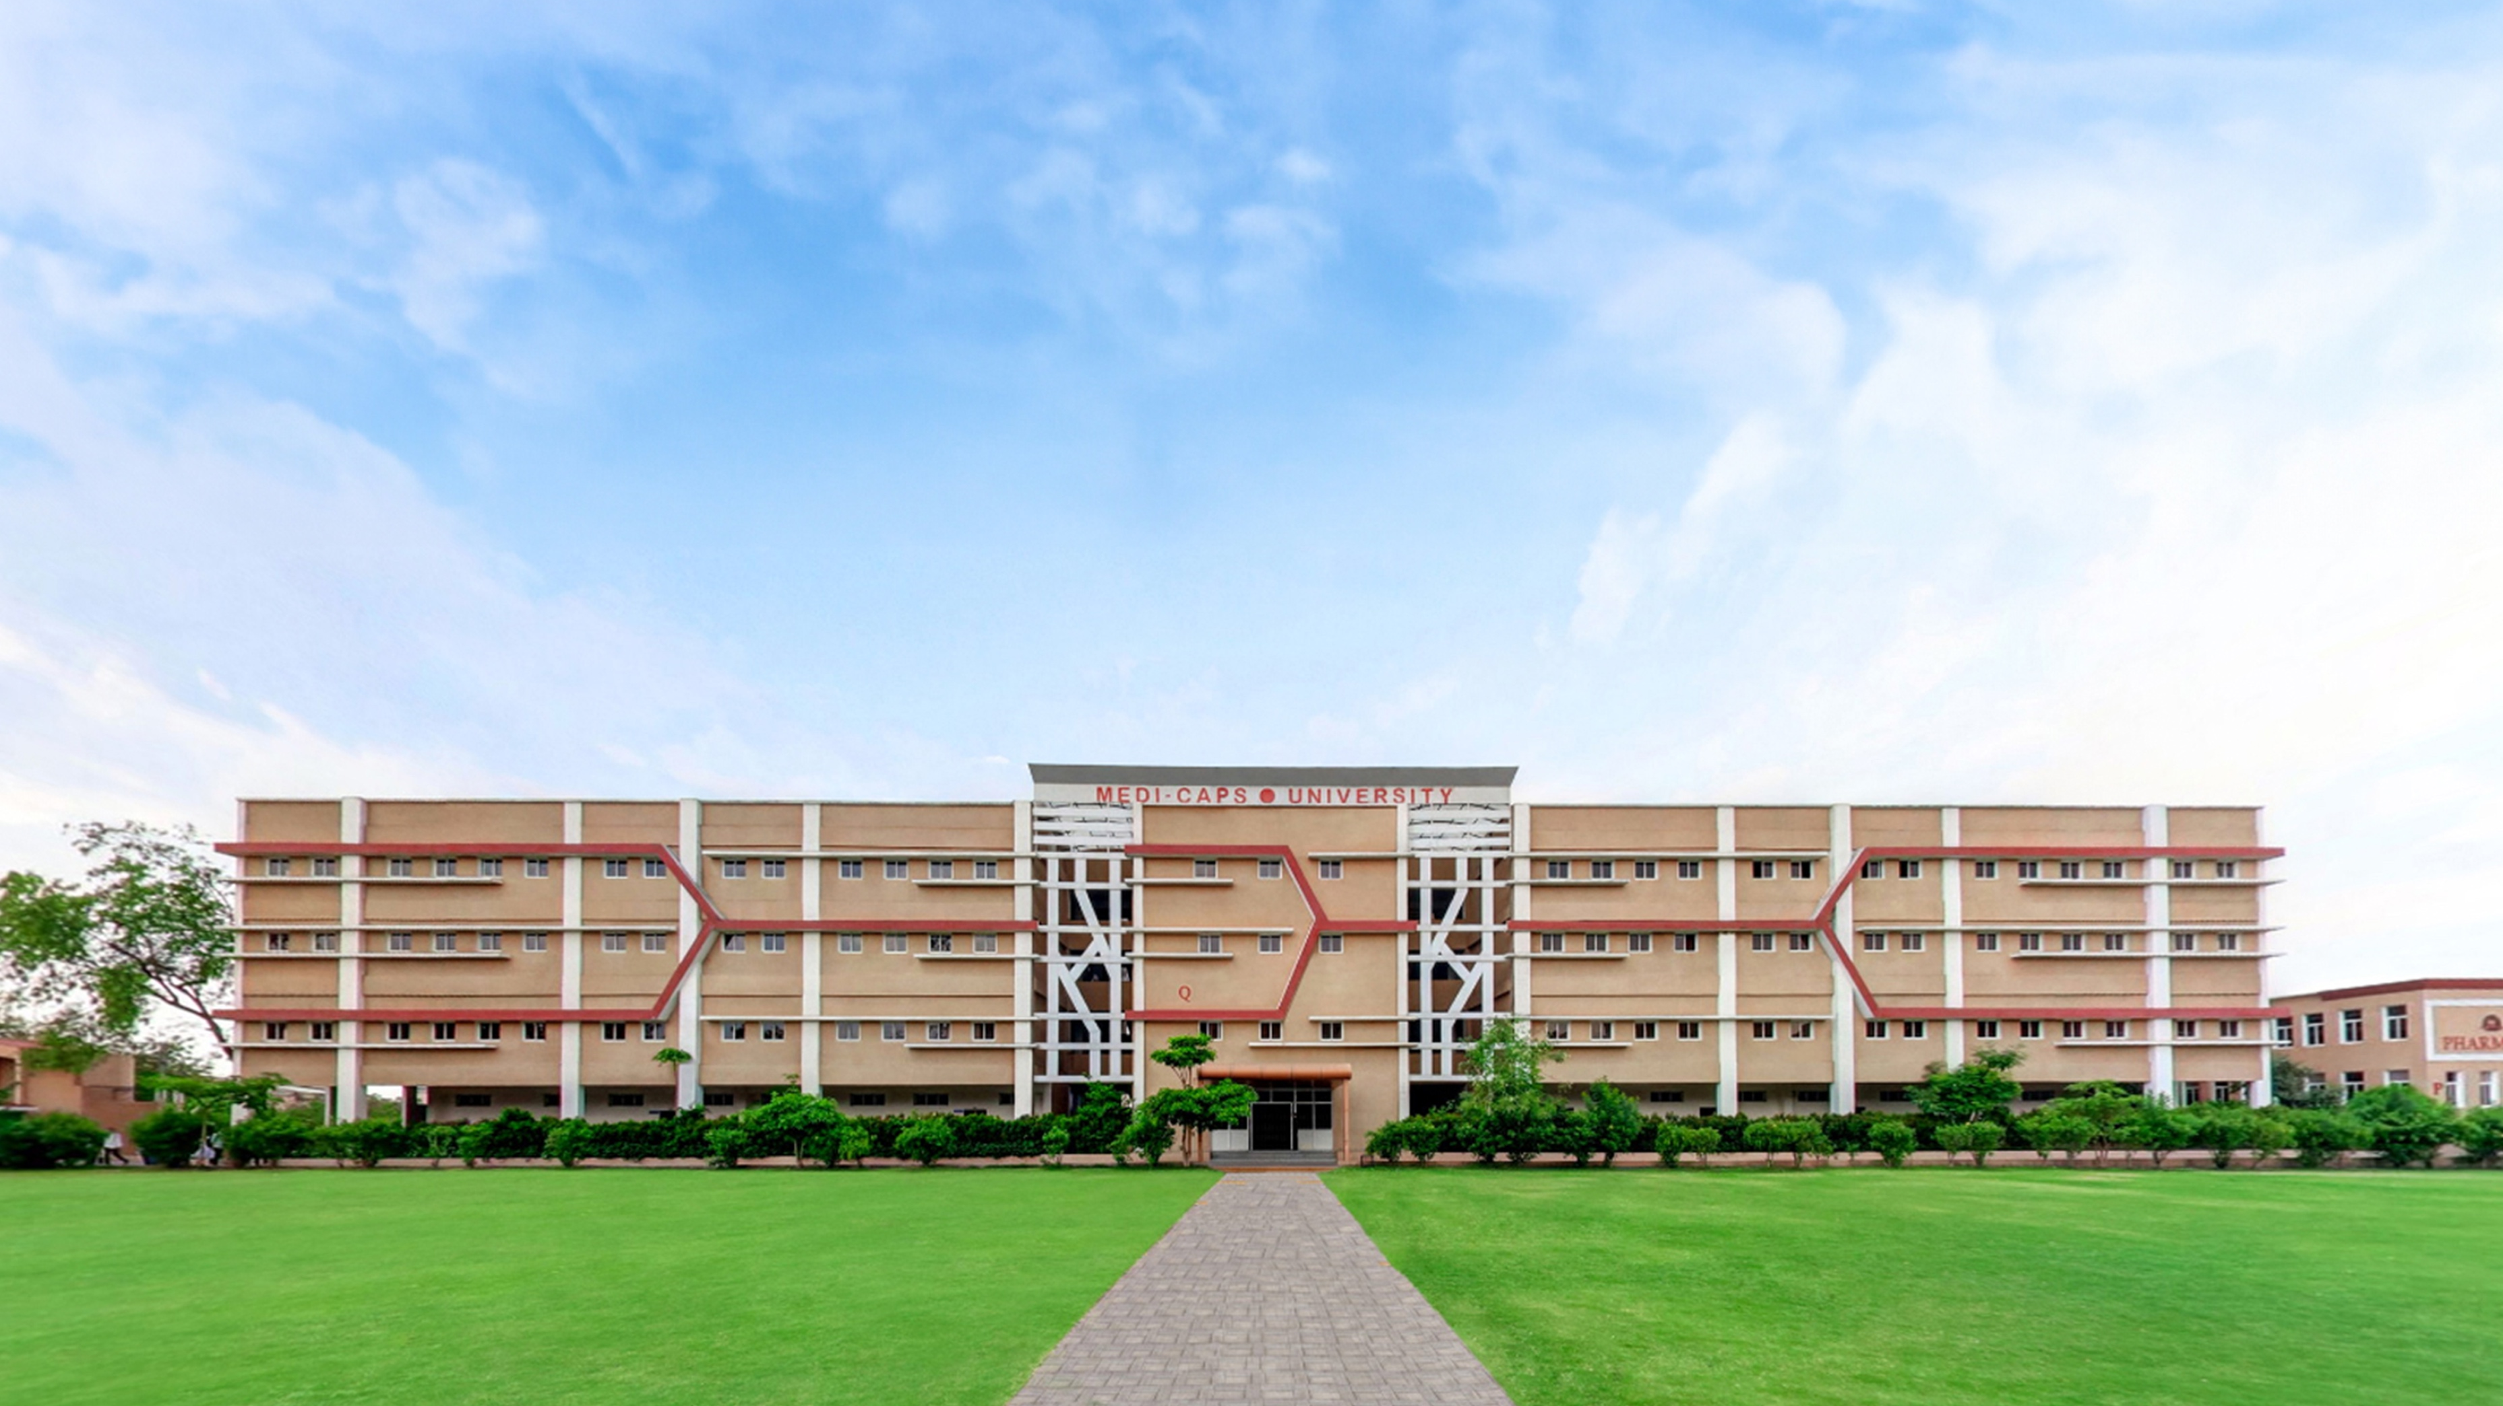

Project-1
2024-2025
By-
Tanishq Solanki
Vishal Patel
Sidhavardhan Singh

Slide 2

ULTRASONIC RADAR SYSTEM

Slide 3
Contents
Abstract
Problem Statement
Technologies Used
Software Requirements Specification
System Features
Design Implementation
Functional Requirements
Non Functional Requirements
Activity Diagrams
Conclusion

Slide 4
Abstract
The application of radio detection and ranging in different places such as military installation, commercial use is done with the help of RADAR SYSTEM which uses electromagnetic waves for detection of different physical components such as distance speed, position, range, direction, size etc which can be either fixed or be in motion. Use of radar system has been developed greatly specially in field of navigation. In this research we study about existing navigation technologies and proposed an Arduino based radar system . It has advantage over other radar system as kit reduces power consumption and connect programmer to wide range or Arduino programmers and open source code. The system consist a basic ultrasonic sensor placed upon a servo motor which rotates at a certain angle and speed. This ultrasonic sensor is connected to Arduino digital input output pins and servo motor also connected to digital input output pins. KEYWORDS- Arduino, Ultrasonic sensor, Servo motor, Simulation,

Slide 5
Problem Statement
Detection Range: The system should detect objects within a specified range (e.g., 0.1 to 5 meters) with a high level of accuracy.
Environmental Adaptability: The system must function effectively in different environments (e.g., indoors, outdoors, in the presence of noise).
Real-Time Processing: The system should process incoming signals and provide distance measurements in real time, with minimal latency.
False Alarm Reduction: Implement algorithms to minimize false detections caused by environmental noise or other interferences.
Power Efficiency: The system should be designed for low power consumption to ensure longer operational periods, particularly in battery-powered applications.

Slide 6
Technologies Used
Ultrasonic Transducers
Microcontrollers
Signal Processing Algorithms
Power Supply Technologies
User Interface Components

Slide 7
Software Requirements Specification
INTRODUCTION:

Slide 8
Design Implementation
Hardware system design for Arduino: Hardware system consist of basically 3 components named as Arduino, servo-motor, and ultra-sonic sensor. Ultrasonic sensor is mounded upon a servo motor which helps it to move and provide it a turning mechanism. Both ultrasonic sensor and servo motor are controlled and powered by Arduino. As given in above figure 2 we can see both ultrasonic sensor and servo motor is powered by Arduino.
System circuit design:

Slide 9
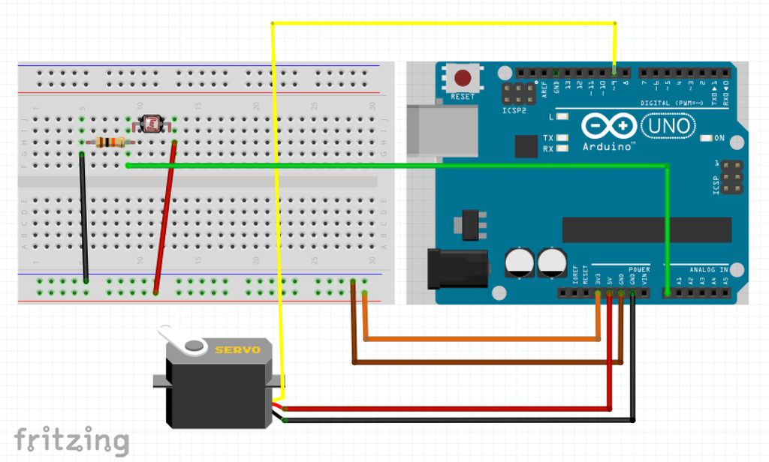

Slide 10
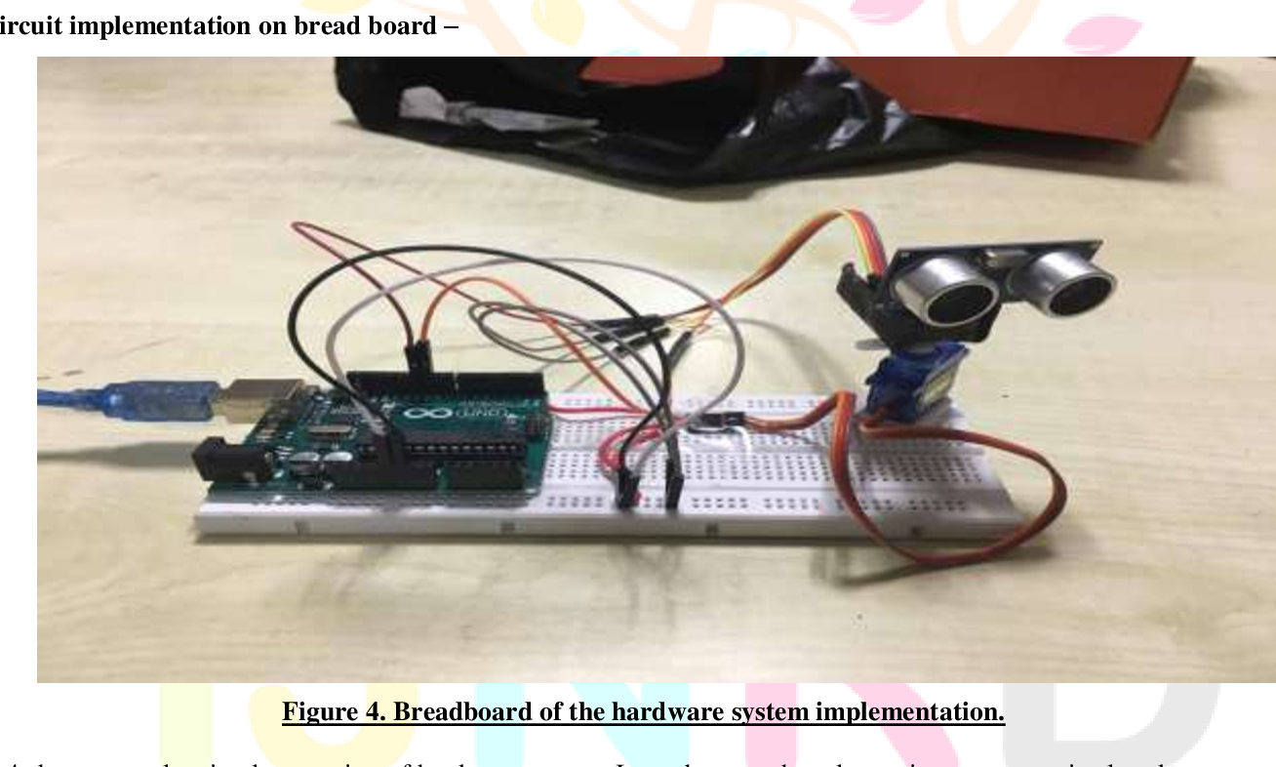
System circuit implementation on bread board

Slide 11
WORKING
The aim of this project is to calculate the distance position and speed of the object placed at some distance from the sensor. Ultrasonic sensor sends the ultrasonic wave in different directions by rotating with help of servo motor. This wave travels in air and gets reflected back after striking some object. This wave is again sensed by the sensor and its characteristics is analysed and output is displayed in screen showing parameters such as distance and position of object.
Arduino IDE is used to write code and upload coding in Arduino and helps us to sense position of servo motor and posting it to the serial port along with the distance of the nearest object in its path. The output of sensor is displayed with the help of processing software to give final output in display screen.

Slide 12
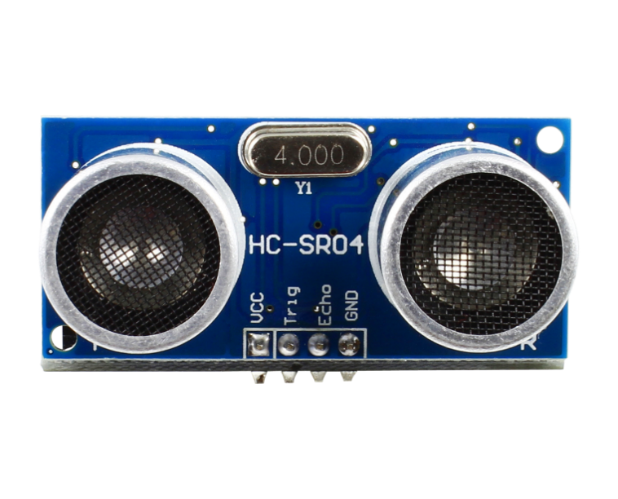
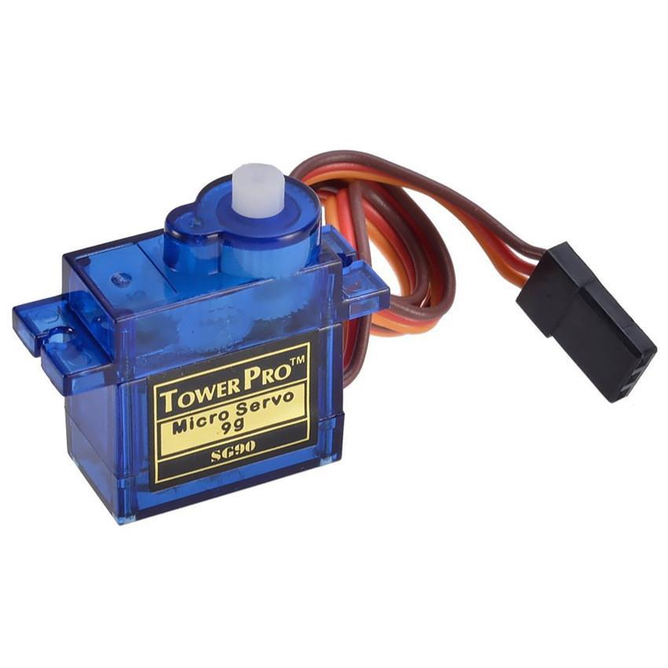
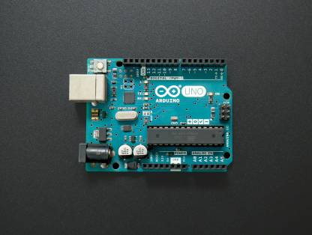
Components Required
Ultrasonic sensor
Servo motor
Arduino

Slide 13
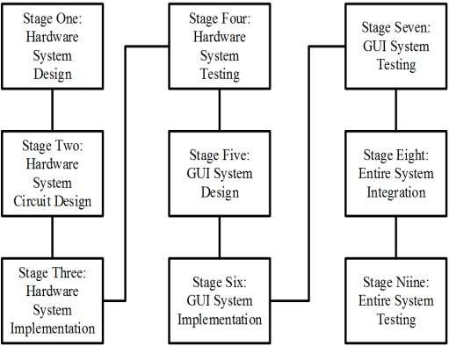
Activity Diagram

Slide 14
Conclusion
In this paper a system radar system was designed with the help of Arduino, servomotor and ultrasonic sensor which can detect the position, distance of obstacle which comes in its way and converts it into visually representable form. This system can be used in robotics for object detection and avoidance system or can also be used for intrusion detection for location sizes. Range of the system depends upon type of ultra-sonic sensor used. We used HC-SR04 sensor which range from 2 to 40 cm

Slide 15
Thank You!

